Slide 1
Predicting Spatial Cropping Patterns
Bruce Babcock, UCR
Medhi Nemati. UCR
Ellen Bruno, UCB

Slide 2
The Project
Overall objective
Develop a model that predicts how changes in water and labor availability will impact California cropping patterns
Motivation
SGMA (Sustainable Groundwater Management Act) will limit groundwater availability to agriculture
Climate change and concerns about fish will limit surface water availability to agriculture and urban areas
Hikes in labor costs differentially impact crops
Need a model to predict the impact of alternative policies regarding labor and water
Only existing model is a proprietary model used by a consulting firm

Slide 3
Determinants of cropping patterns
Growers select crops based on expected returns
Expected returns depend on crop yields and prices
Crop yields depend on interaction of climate, water, labor, soils, and management
Need to understand why different crops are planted in different locations
Price and labor availability do not vary much across space
Water price (availability) and soils vary dramatically across space

Slide 4
Proposed class project
Develop measures of spatial correlation between soils and crops
Overlay that data onto the new groundwater management districts

Slide 5
USDA Crop Data Layer Exists

Slide 6
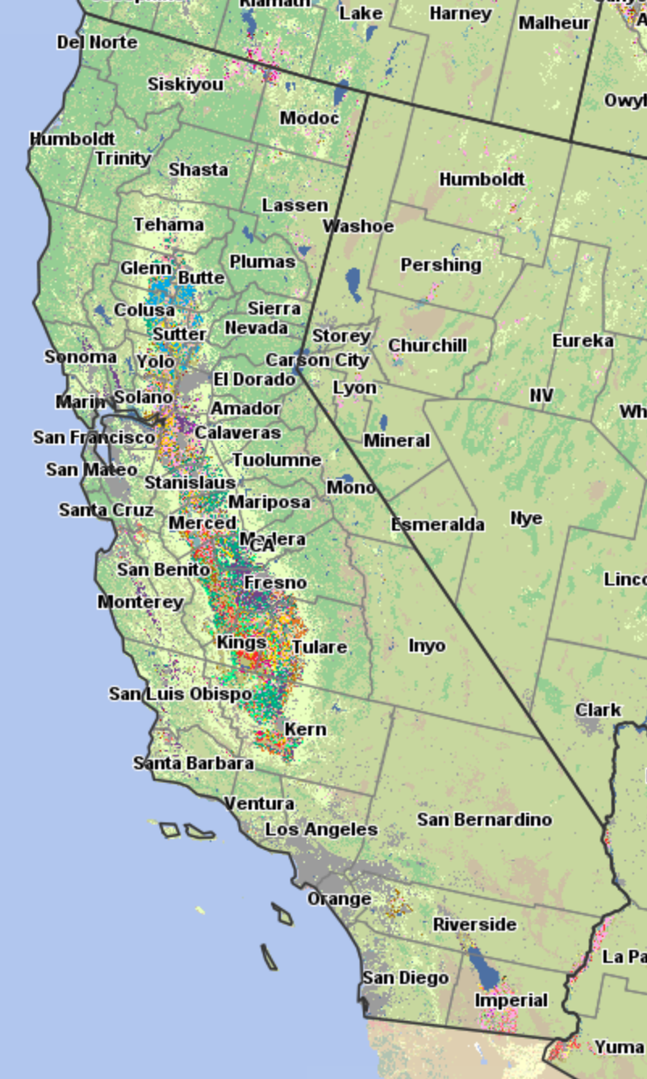
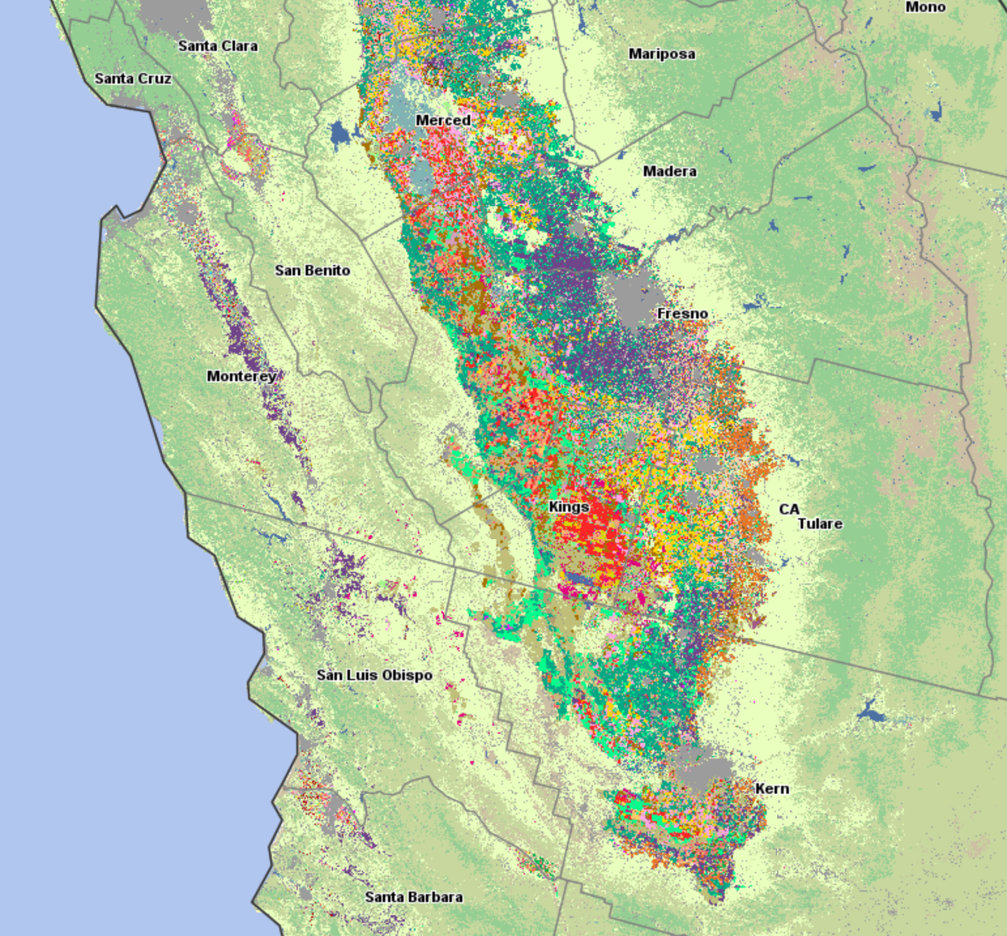

Slide 7
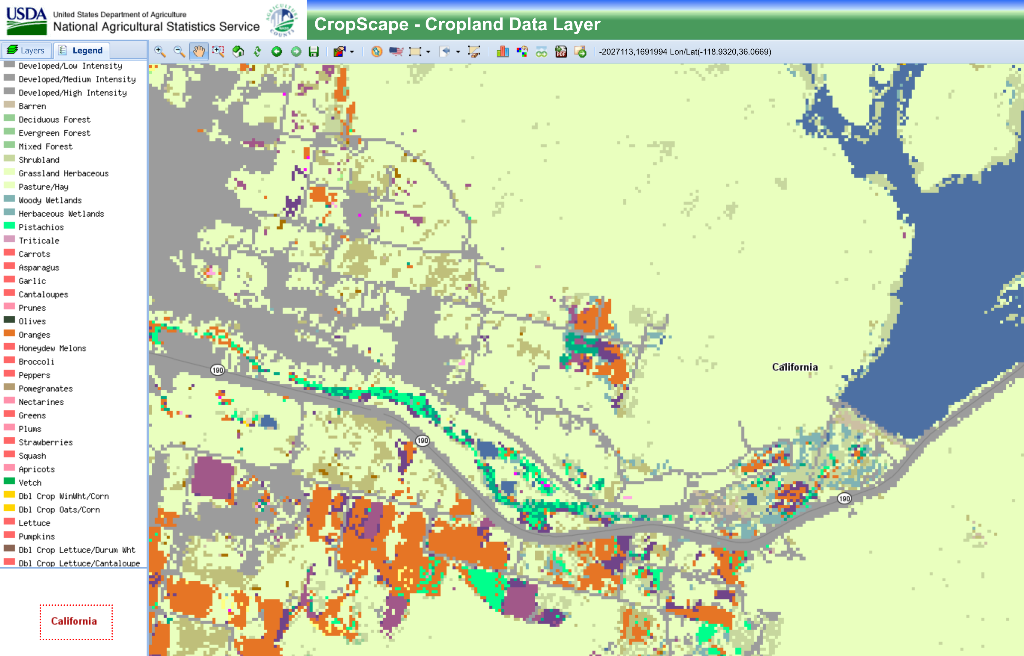

Slide 8
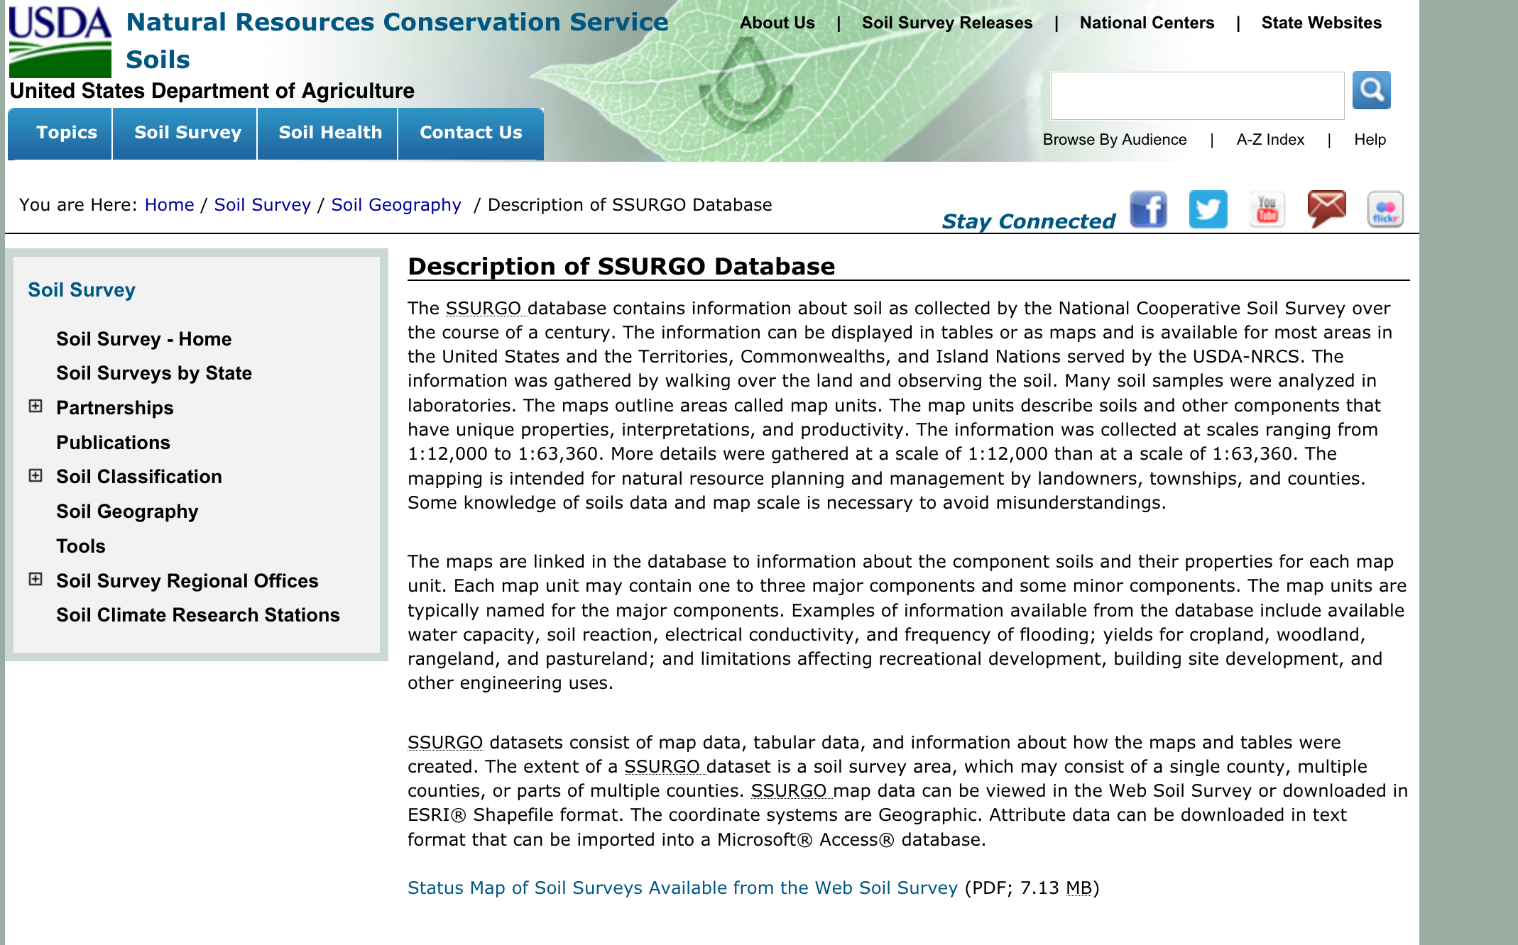
Soil data exists

Slide 9
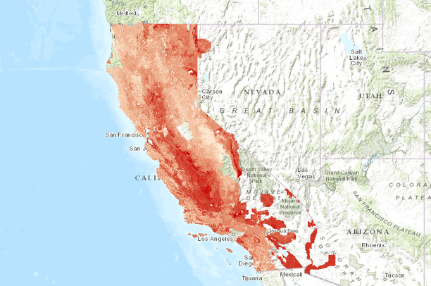
Soil PH

Slide 10
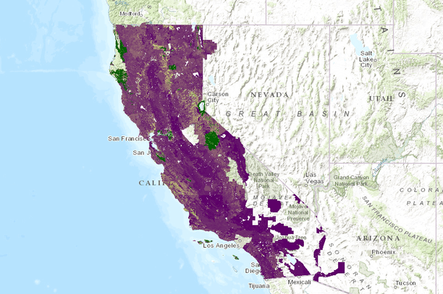
% soil organic matter

Slide 11
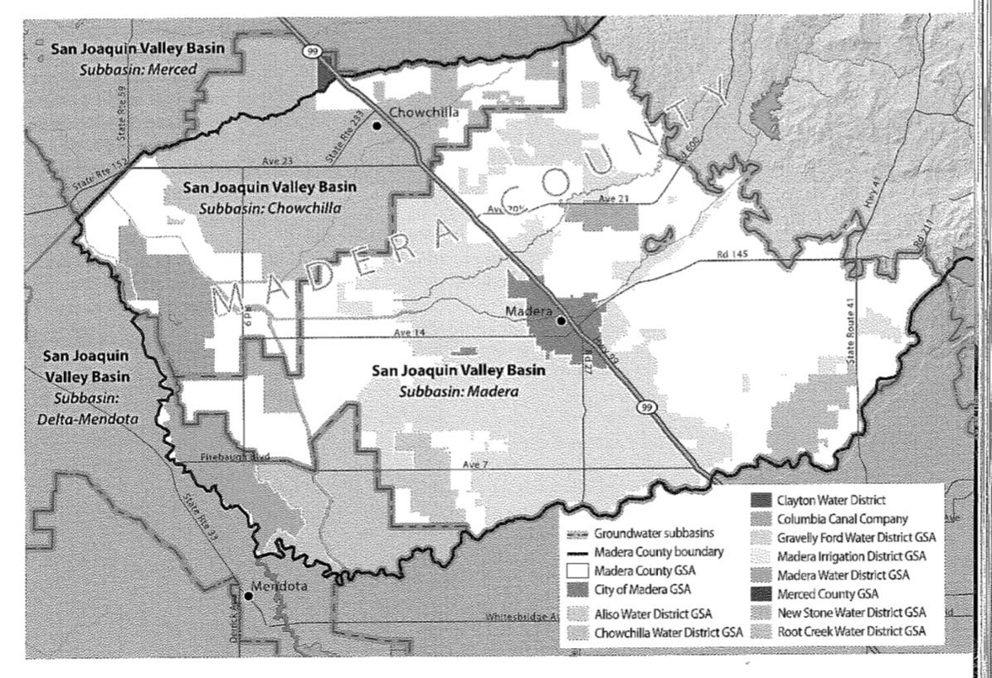
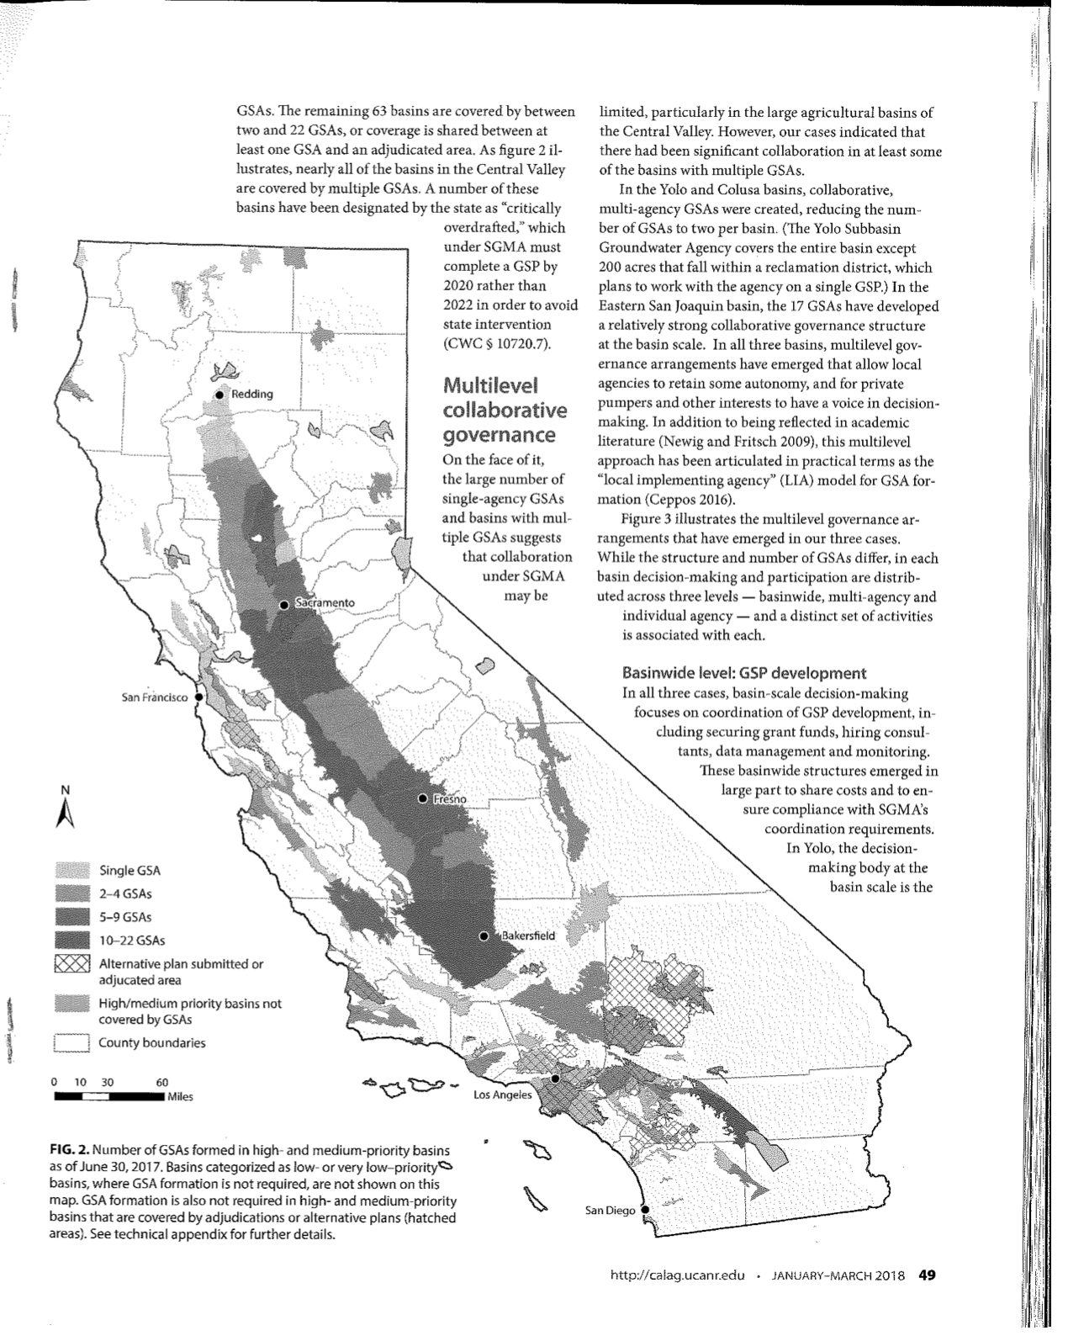
Data delineating the boundaries of groundwater basins exist

Slide 12
Outcomes
At a minimum: Organized data set that links variables spatially and perhaps temporally
Maybe? Start looking for spatial patterns in the data that will guide subsequent work.

